Slide 1
Stanford ME469: A Validation Methodology:
Code and Solution Verification; Review
Stefan P. Domino
Computational Thermal and Fluid Mechanics
Sandia National Laboratories SAND2018-4536 PE

Slide 2
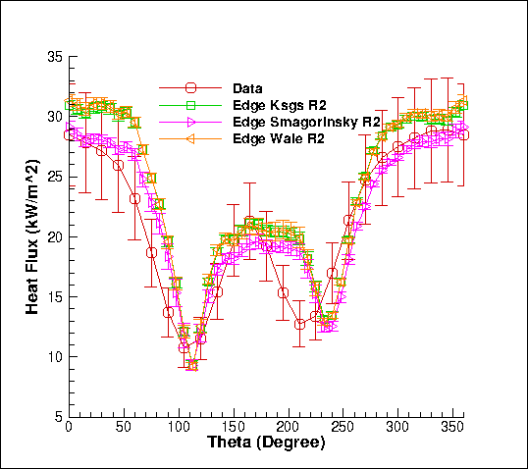
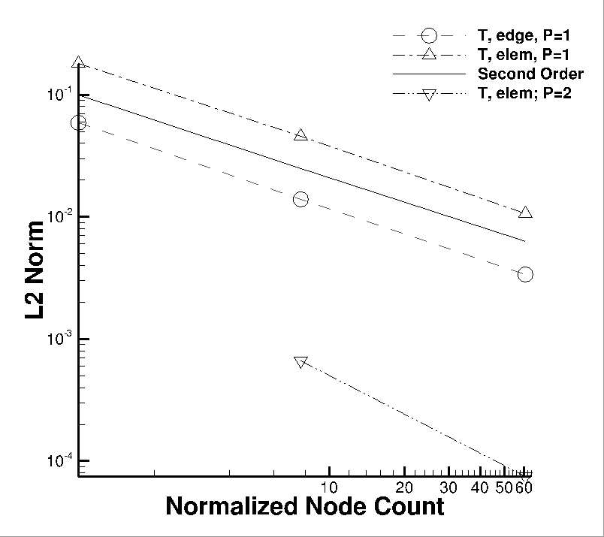
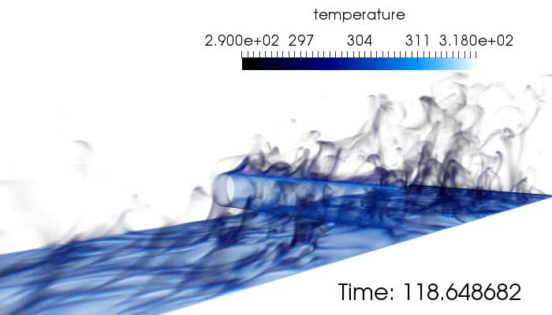
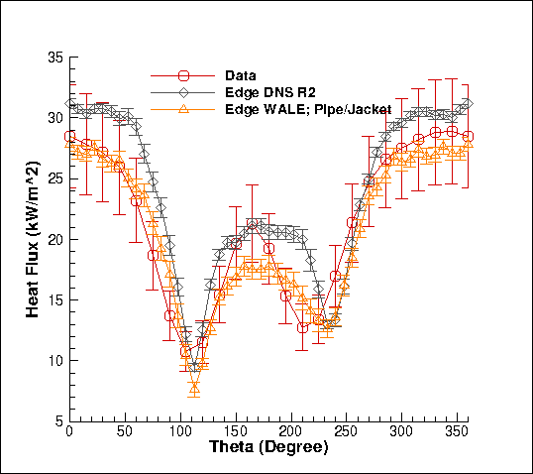
Review of a Strong V&V Process LES-based
Numerical UQ
Established a sound LES-based verification and validation process (with uncertainty quantification) that includes the following attributes:
Definition of key physics, Phenomena Identification Ranking Table (PIRT)
Code implementation and verification
Validation including solution verification (meshes with converged statistics)
Structural uncertainty, i.e., model form, quantification
Physics assumptions, i.e., your conceptual model
Structural UQ
Non-isothermal MMS
Physics UQ
10x
reduction
“An assessment of atypical mesh topologies for low-Mach LES”, Domino et al., Comp & Fluids, 2019

Slide 3
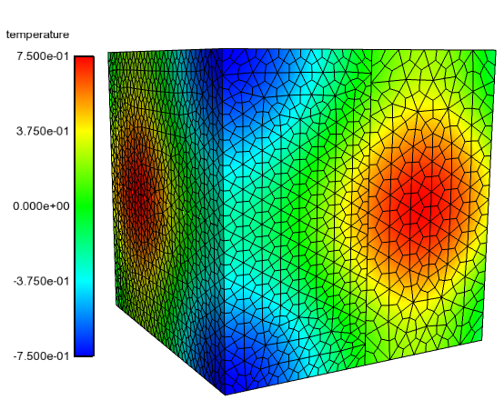
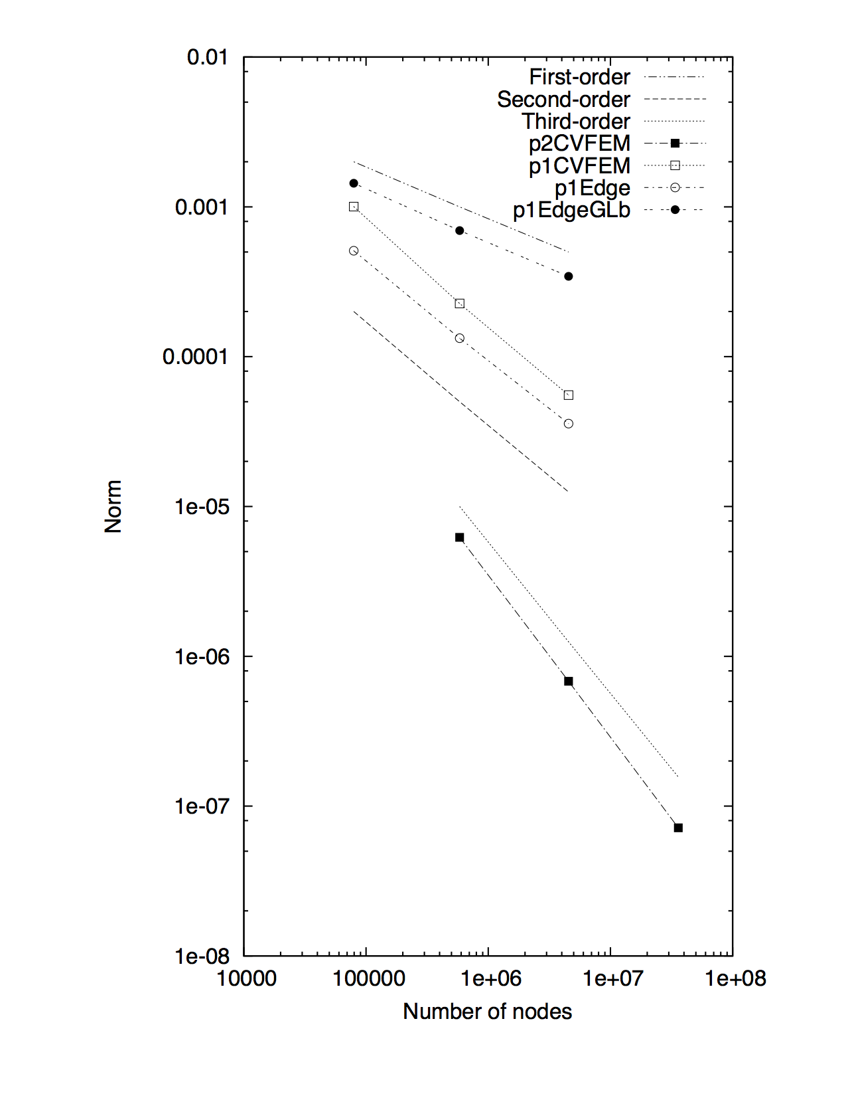

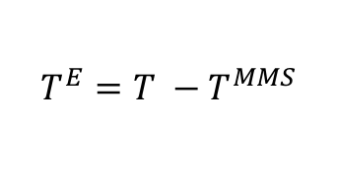



Review of the Method of Manufactured Solutions (MMS)
Providing confidence that the code implementation converges to the proper solution
For complex low-Mach fluid flow applications, there are very few analytical solutions
Consider an approach whereby the solution is manufactured (Roache, et al, 1990)
Simple thermal heat conduction PDE:
with manufactured analytical form for T:
Placing this MMS back into model PDE:
provides the source term:
with error now provided by:
$$ρC_{p} \frac{∂T}{∂t}−\frac{∂}{∂x_{j}}λ\frac{∂T}{∂x_{j}}=0$$
$$T^{MMS}=\frac{1}{4}\left[\cos\left(2απx\right)\text{+}\cos\left(2απy\right)+ cos⁡(2απz)\right]$$
$$ρC_{p} \frac{∂T^{MMS}}{∂t}−\frac{∂}{∂x_{j}}λ\frac{∂T^{MMS}}{∂x_{j}}=S^{MMS}$$
$$S^{MMS}=\frac{λ}{4}{\left(2απ\right)}^{2}\left[cos\left(2απx\right)\text{+}cos\left(2απy\right)\text{+}cos\left(2απz\right)\right]$$
$$T^{E}={T −T}^{MMS}$$
Physics-based approaches…

